Slide 1
Grammars and Constituency Parsing
Jurafsky and Martin Chapters 12 and 13

Slide 2
Reminders
Homework 7 due Date is postponed to 3/18
Quiz is due tonight by 11:59pm

Slide 3
Formal Definition of a CFG
A context-free grammar G is defined by four parameters: N, Σ, R, S
N is a set of non-terminal symbols (or variables)
In NLP, we often use the Penn Treebank tag set
Σ is set of terminal symbols
These are the words (also sometimes called the leaf nodes of the parse tree)
R is a set of production rules, each of the form A → β
S → Aux NP VP
Nominal → Nominal Gerund VP (recursive)
S is the start symbol (a non-terminal)
Notes:
CFGs are something that we study in both linguistics and computer science. In computer science we study them in courses on Automata Theory, Languages, and Computation.

Slide 4
Where do grammars come from?
Linguists
Write symbolic grammar (CFG or often richer) and lexicon
S → NP VP NN → interest
NP → (DT) NN NNS → rates
NP → NN NNS NNS → raises
NP → NNP VBP → interest
VP → V NP VBZ → rates
Noam Chomsky
Ivan Sag
Joan Bresnan

Slide 5
Coverage of grammars
Manually written grammars have two problems.
Coverage – the tend to only cover a subset of a language, since actual language use is widely varied and hugely complex. Therefore writing a broad coverage grammar by hand takes an entire career.
Overgeneration – writing rules that will only generate grammatical sentences is hard. Broad coverage tends to come at the expense of overgeneration.
Ann Copestake
Dan Flickinger
Mark Steedman
Arvind Joshi

Slide 6
Treebanks as grammar
Treebanks == data
Initially, building a treebank might seem like it would be a lot slower and less useful than building a grammar.
However, a treebank gives us many things
Reusability of the labor
Many parsers, POS taggers, etc.
Valuable resource for linguistics
Broad coverage
Frequencies and distributional information
A way to evaluate systems
Mitch Marcus
[Marcus et al. 1993, Computational Linguistics]

Slide 7

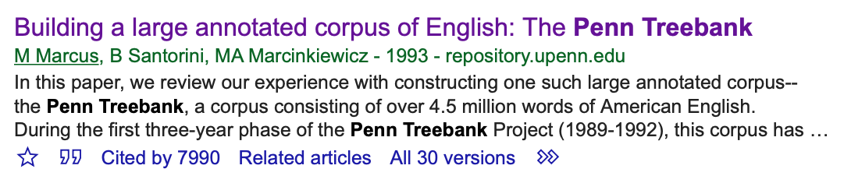
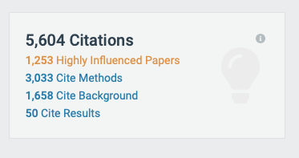
Notes:
Mitch Marcus, Beatrice Santorini, Mary Ann Marcinkiewicz

Slide 8
Extracted rules
S → NP VP . | DT → That | JJ → full
NP → DT JJ , JJ NN | JJ → cold | IN → of
VP → VBD ADJP | , → , | NN → fire
ADJP → JJ PP | JJ → empty | CC → and
PP → IN NP | NN → sky | NN → light
NP → NN CC NN | VBD → was
Notes:
For simplicity, let’s strip off the rule suffixes (-SBJ and so on).

Slide 9
Some of the rules, with counts
40717 PP → IN NP
33803 S → NP-SBJ VP
22513 NP-SBJ → -NONE-
21877 NP → NP PP
20740 NP → DT NN
14153 S → NP-SBJ VP .
12922 VP → TO VP
11881 PP-LOC → IN NP
11467 NP-SBJ → PRP
11378 NP → -NONE-
11291 NP → NN
...
989 VP → VBG S
985 NP-SBJ → NN
983 PP-MNR → IN NP
983 NP-SBJ → DT
969 VP → VBN VP
100 VP → VBD PP-PRD
100 PRN → : NP :
100 NP → DT JJS
100 NP-CLR → NN
99 NP-SBJ-1 → DT NNP
98 VP → VBN NP PP-DIR
98 VP → VBD PP-TMP
98 PP-TMP → VBG NP
97 VP → VBD ADVP-TMP VP
...
10 WHNP-1 → WRB JJ
10 VP → VP CC VP PP-TMP
10 VP → VP CC VP ADVP-MNR
10 VP → VBZ S , SBAR-ADV
10 VP → VBZ S ADVP-TMP
4500 rules
for VP!
Notes:
Any guesses on how many unique VP rules there are?

Slide 10
Redundant rules?
The Penn Treebank by this series of rules:
VP → VBD NP PP VP → VBD NP PP PP VP → VBD NP PP PP PP VP → VBD NP PP PP PP PP
We can also represent that with a two-rule grammar as
VP → VBD NP PP VP → VP PP

Slide 11
NP rules
NP → DT JJ NN NP → DT JJ NNS NP → DT JJ NN NN NP → DT JJ JJ NN NP → DT JJ CD NNS NP → RB DT JJ NN NN NP → RB DT JJ JJ NNS NP → DT JJ JJ NNP NNS NP → DT NNP NNP NNP NNP JJ NN NP → DT JJ NNP CC JJ JJ NN NNS NP → RB DT JJS NN NN SBAR NP → DT VBG JJ NNP NNP CC NNP NP → DT JJ NNS , NNS CC NN NNS NN NP → DT JJ JJ VBG NN NNP NNP FW NNP NP → NP JJ , JJ ‘‘ SBAR ’’ NNS
[DT The] [JJ state-owned] [JJ industrial] [VBG holding] [NN company] [NNP Instituto] [NNP Nacional] [FW de] [NNP Industria]
[NP Shearson’s] [JJ easy-to-film], [JJ black-and-white] “[SBAR Where We Stand]” [NNS commercials]

Slide 12
Chomsky normal form
Real rules extracted from the Penn Treebank can get crazy. We can derive an equivalent grammar by converting the rules into binary branching rules.
A→B C D
can be converted to two rules:
A→B X X→C D
These are called Chomsky Normal Form rules. The resulting binary branching grammar is weakly equivalent because it generates the same set of strings but assigns different phrase structures to sentences.

Slide 13
Lexical Heads
Notes:
Modern linguistic theories of syntax like Head Driven Phrase Structure generally include a component that defines heads.
For the generation of such a tree, each CFG rule must be augmented to identify one right-side constituent to be the head child

Slide 14
Lexicalized Grammars
Unlike rules derived from the Penn Treebank, which tends to emphases phrase structure rules, many modern syntactic theories emphasize the role of the lexicon. The lexicon can encode information like subcategorization frames.
HPSG – Head-driven phrase structure grammars
LFG – Lexical functional grammars
TAG – Tree adjoining Grammar
CCG – Combinatory Categorial Grammar

Slide 15
Combinatory Categorial Grammar (CCG)
A set of categories, a lexicon that associates words with categories, and a set of rules that govern how categories combine in context.
word | category
flight | N | atomic
Miami | NP | atomic
cancel | (S\NP)/NP | complex category / function
Notes:
Ditransitive verbs like give, which expect two arguments after the verb, would have the category

Slide 16
Parsing in CCG
Rules are simple:
X/Y Y ⇒ X forward function application Y X\Y ⇒ X backward function application

Slide 17
Parsing in CCG
Rules are simple:
X/Y Y ⇒ X forward function application Y X\Y ⇒ X backward function application
X CONJ X ⇒ X Conjunction

Slide 18
CCG Bank
Julia Hockenmaier created a treebank for CCG. It was created by translating phrase-structure trees from the Penn Treebank.
It resulted in 48,934 sentences paired with CCG derivations, and a lexicon with 44,000 words and 1200 categories.
Julia Hockenmaier

Slide 19
Constituency Parsing
Jurafsky and Martin Chapter 13

Slide 20
Headlines
Iraqi Head Seeks Arms
Juvenile Court to Try Shooting Defendant
Teacher Strikes Idle Kids
Stolen Painting Found by Tree
Kids Make Nutritious Snacks
Local High School Dropouts Cut in Half
British Left Waffles on Falkland Islands
Red Tape Holds Up New Bridges
Ban on Nude Dancing on Governor’s Desk
Trump Wins on Economy, but More Lies Ahead
Examples from Chris Manning, Jason Eisner, and Andrew McCallum

Slide 21
Ambiguity
Ambiguity can arise because of words with multiple senses or POS tags. Many kinds of ambiguity are also structural.

Slide 22
Attachment Ambiguity
Notes:
Another example: We saw the Eiffel Tower flying to Paris.

Slide 23
Parsing Algorithms
NLP systems need to choose a single correct parse from many, many possible parses. They need to perform syntactic disambiguation.
Effective disambiguation algorithms require a variety of information to be integrated into parsing algorithms. Such information includes:
statistical information
semantic understanding
contextual knowledge
We’ll start by looking at an efficient dynamic programming algorithm, and then see how to add statistics to it.

Slide 24
The Parsing Problem
Given sentence x and grammar G,
Recognition
Is sentence x in the grammar? If so, prove it.
“Proof” is a deduction, valid parse tree.
Parsing
Show one or more derivations for x in G.
Even with small grammars, brute force grows exponentially!
“Book that flight”

Slide 25
Left to Right?
The old man the boat.
The complex houses married and single soldiers and their families.
Garden Path Sentences
Notes:
[NP The old] [VP man the boat]
versus garden path
[NP The old man] [VP-Expected the boat]
[NP The complex] [VP [V houses] married ….]

Slide 26
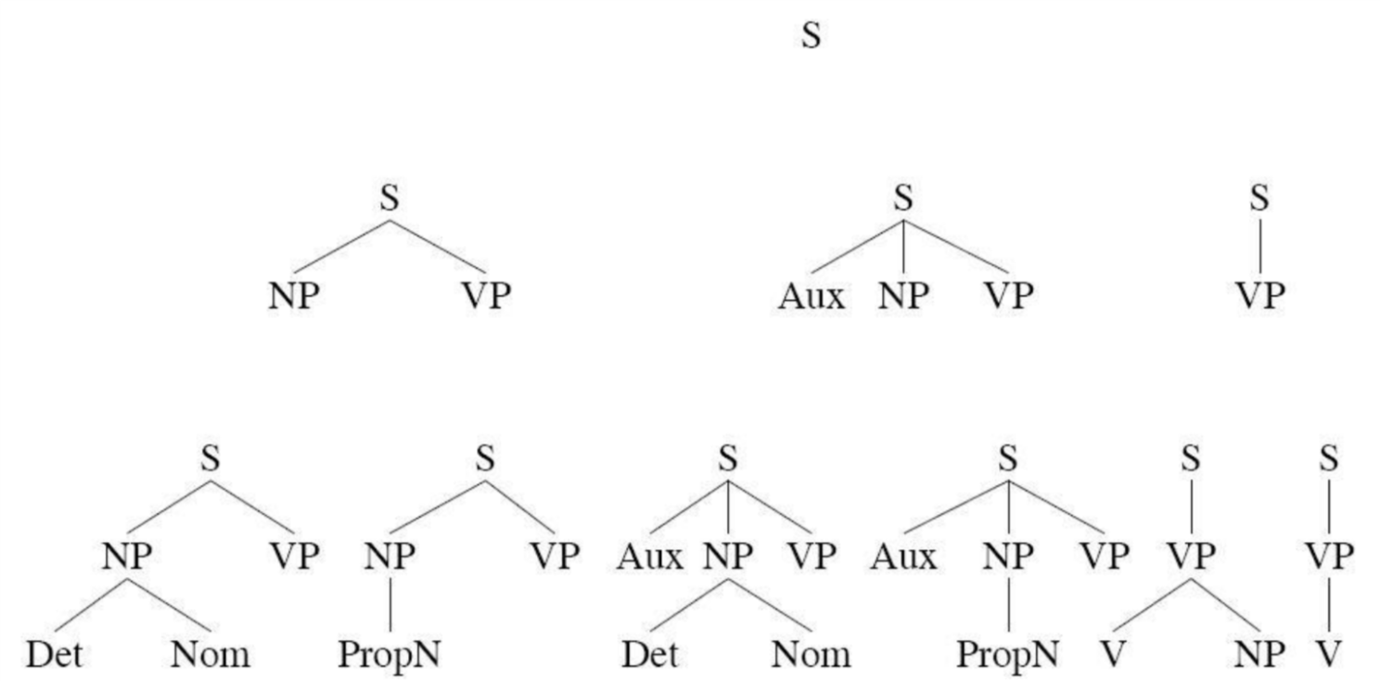
Top Down Parsing
“Book that flight”
Considers only valid trees
But are inconsistent with the words!

Slide 27
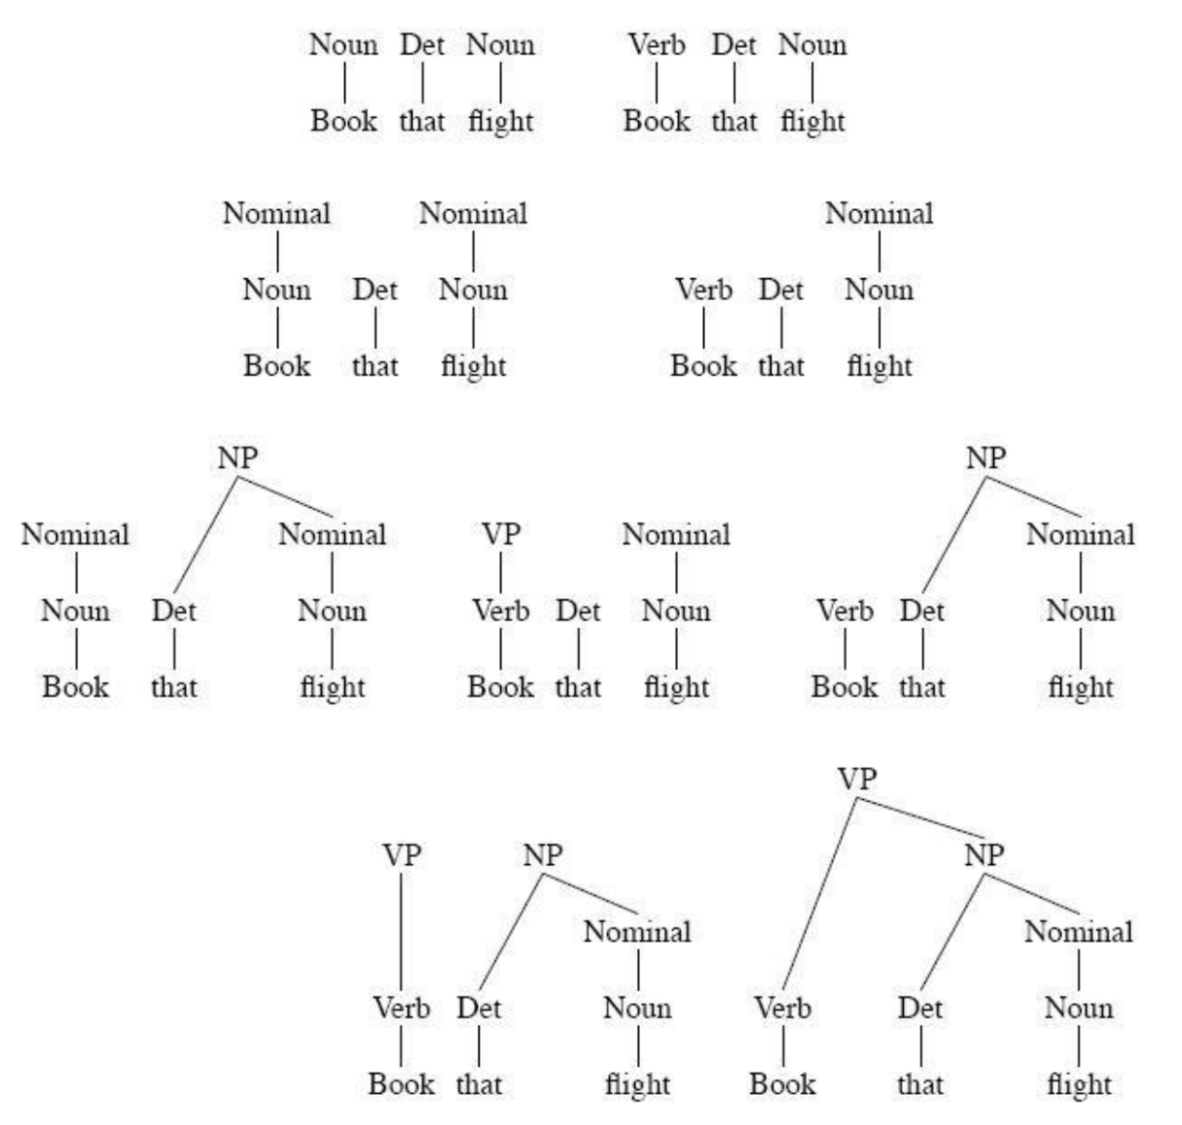
Bottom-up Parsing
“Book that flight”
Builds only consistent trees
But most of them are invalid (don’t go anywhere)!

Slide 28
Chomsky Normal Form
Context free grammar where all non-terminals to go:
2 non-terminals, or
A single terminal
A → B C
D → w
Converting to CNF
Case 1
Case 2
A → B
B → C D
B → w
A → C D
A → w
A → X E
X → Y D
Y → B C
A → B C D E

Slide 29
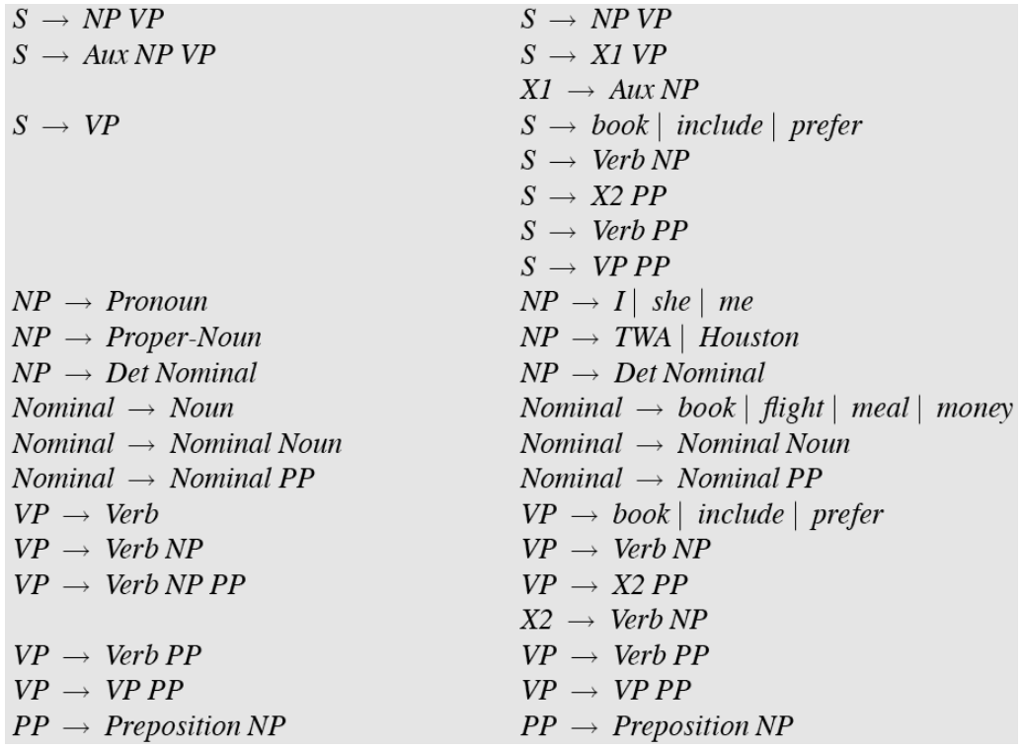
Original Grammar
Chomsky Normal Form

Slide 30
Dynamic Programming
table[i,j] = Set of all valid non-terminals for the constituent span (i,j)
A
(j-1,j)
Rule: A → word[j]
Base case
A should be in table[j-1,j]
word[j]
Recursion
Rule: A → B C
(i,j)
A
If you find a k such that
B is in table[i,k], and
C is in table[k,j], then A should be in table[i,j]
C
B
(i,k)
(k,j)

Slide 31
Dynamic Programming
table[i,j] = Set of all valid non-terminals for the constituent span (i,j)
A
(j-1,j)
Rule: A → word[j]
Base case
A should be in table[j-1,j]
word[j]
Recursion
Rule: A → B C
(i,j)
A
If you find a k such that
B is in table[i,k], and
C is in table[k,j], then A should be in table[i,j]
C
B
(i,k)
(k,j)

Slide 32
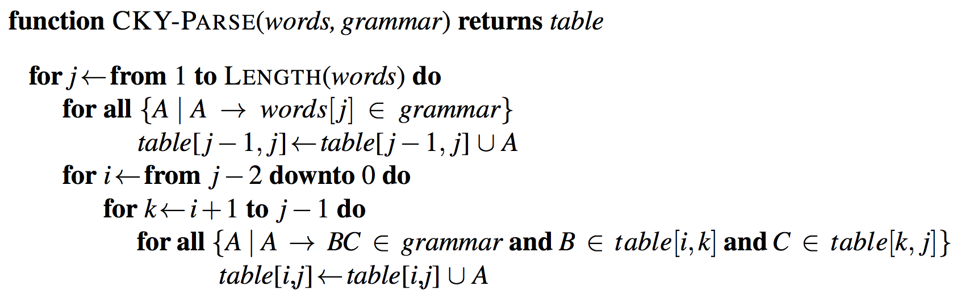
CKY Algorithm
Notes:
Show demo: http://lxmls.it.pt/2015/cky.html
The outermost loop of the algorithm iterates over the columns, and the second loop iterates over the rows, from the bottom up.
The purpose of the innermost loop is to range over all the places where a substring spanning i to j in the input might be split in two.
As k ranges over the places where the string can be split, the pairs of cells we consider move, in lockstep, to the right along row i and down along column j.

Slide 33
CKY Algorithm
j
Book
the
flight
through
TWA
[0,1]
[0,2]
[0,3]
[0,4]
[0,5]
[1,2]
[1,3]
[1,4]
[1,5]
i
[2,3]
[2,4]
[2,5]
[3,4]
[3,5]
[4,5]
Notes:
01, S VP Verb Nom Noun; 12, Det; 23 Nom N; 3,4 Prep; 4,5 NP, Proper
13 NP; 35 PP;
03, S, VP, X2; 25, Nom
15 NP
05 X2, VP, VP, S(01,15), S(03,35,X2 PP), S(03,35,VP PP)

Slide 34
CKY Algorithm
Book
the
flight
through
TWA
Notes:
01, S VP Verb Nom Noun; 12, Det; 23 Nom N; 3,4 Prep; 4,5 NP, Proper
13 NP; 35 PP;
03, S, VP, X2; 25, Nom
15 NP
05 X2, VP, VP, S(01,15), S(03,35,X2 PP), S(03,35,VP PP)

Slide 35
CKY Algorithm

Slide 36
CKY Algorithm: Complexity
|N|: Number of non-terminals
|R|: Number of rules
n: Number of tokens in the sentence
Memory
Time
Notes:
Nn^2 and Rn^3

Slide 37
CKY Algorithm: Complexity
|N|: Number of non-terminals
|R|: Number of rules
n: Number of tokens in the sentence
Memory
Time
Notes:
Nn^2 and Rn^3

Slide 38
Outline
Parsing: CKY Algorithm
Extensions: Probabilistic and Lexicalized
Dependency Parsing

Slide 39
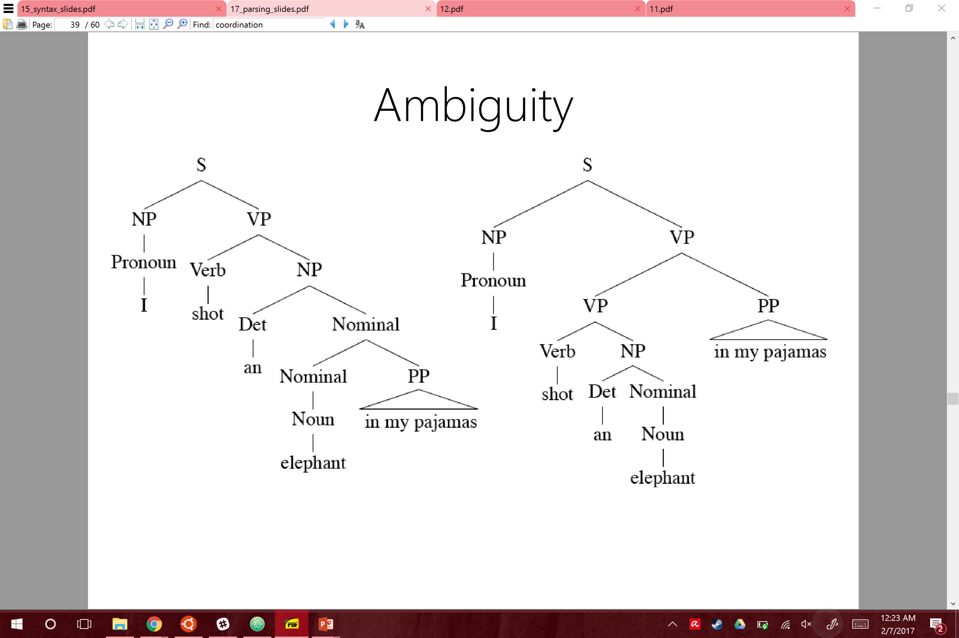
Ambiguity: Which parse?
I shot an elephant in my pajamas.

Slide 40
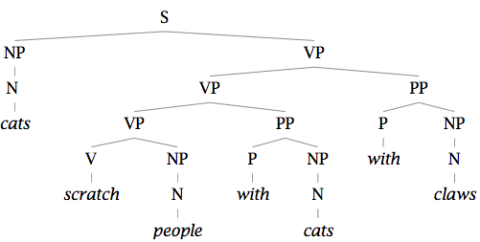
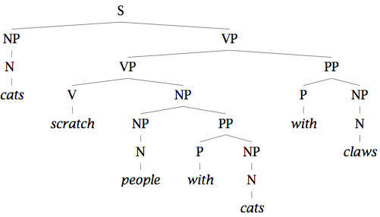
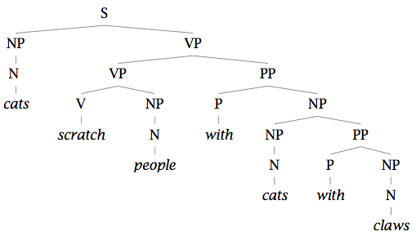
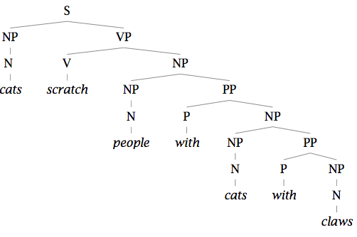
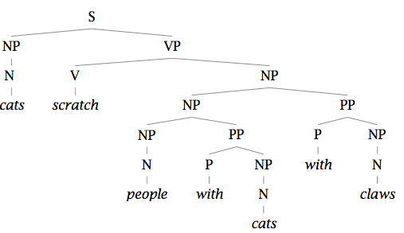
Finding the Best Parse Tree
Cats scratch people with cats with claws.

Slide 41
Finding the Best Parse Tree
Cats scratch people with cats with claws.

Slide 42
Probabilistic CFGs
Same as a regular context-free grammar:
Terminal, non-terminals, and rules
Additionally, attach a probability to each rule!
Rule: A → B C
Probability: P(A → B C | A)
Compute the probability of a parse tree:

Slide 43
Probabilistic CFGs
Same as a regular context-free grammar:
Terminal, non-terminals, and rules
Additionally, attach a probability to each rule!
Rule: A → B C
Probability: P(A → B C | A)
Compute the probability of a parse tree:

Slide 44
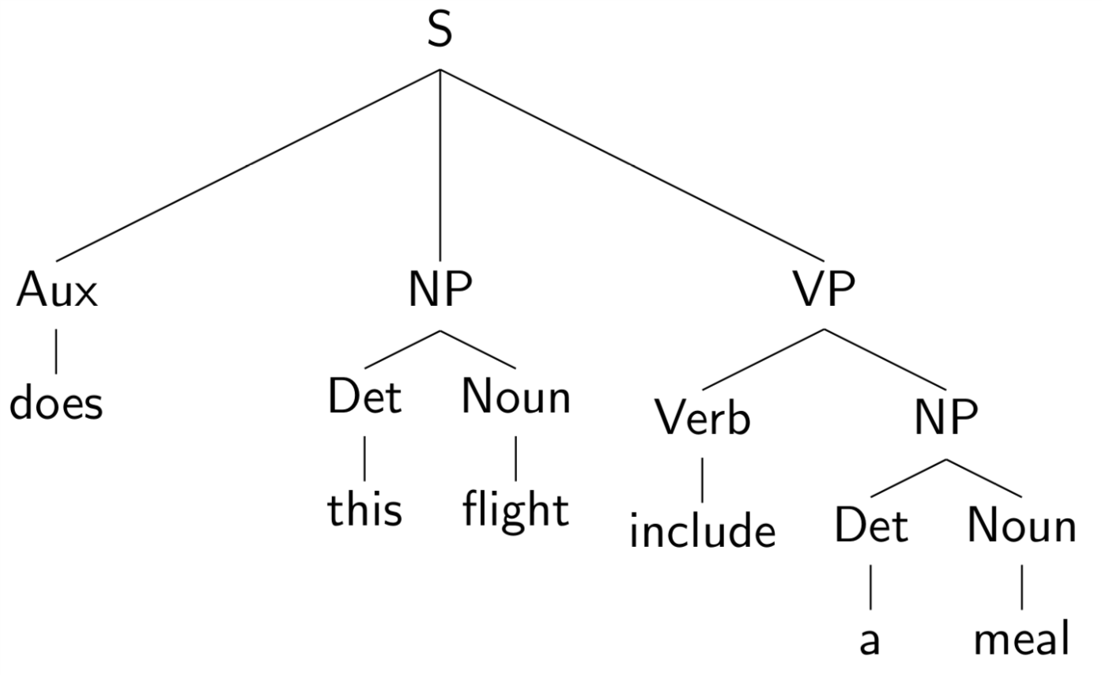
Example of a PCFG

Slide 45
Example of a PCFG

Slide 46
Estimating the probabilities

Slide 47
Estimating the probabilities

Slide 48
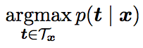
The Parsing Problem
Given sentence x and grammar G,
Recognition
Is sentence x in the grammar? If so, prove it.
“Proof” is a deduction, valid parse tree.
Parsing
Show one or more derivations for x in G.
Even with small grammars, grows exponentially!

Slide 49
Probabilistic CKY Algorithm
T[i,j,A] = Probability of the best parse with root A for the span (i,j)
A
(j-1,j)
Rule: P( A → word[j] )
Base case
T[j-1,j,A] = P(word[j] | A)
word[j]
Recursion
Rule: P( A → B C )
(i,j)
A
Try every position k, and every non-terminal pair:
B
C
T[i,j,A] = max P(B C| A) T[i,k,B] T[k,j,C]
(i,k)
(k,j)

Slide 50
Lexicalized PCFGs

Slide 51
Lexicalized PCFGs

Slide 52
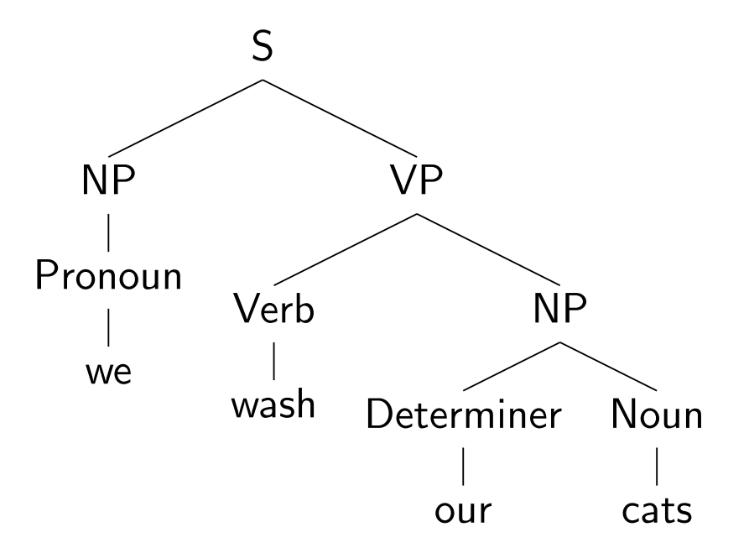
Lexicalizing a CFG

Slide 53
Lexicalizing a CFG

Slide 54
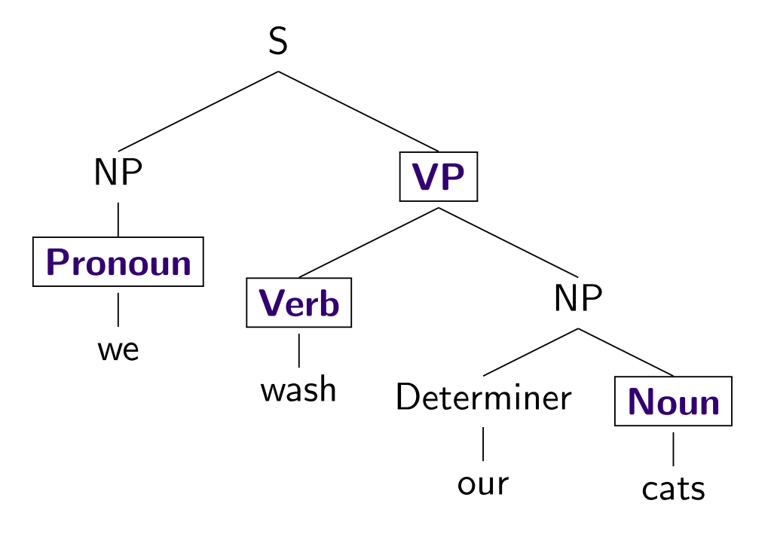
Lexicalizing a CFG

Slide 55
Lexicalizing a CFG

Slide 56
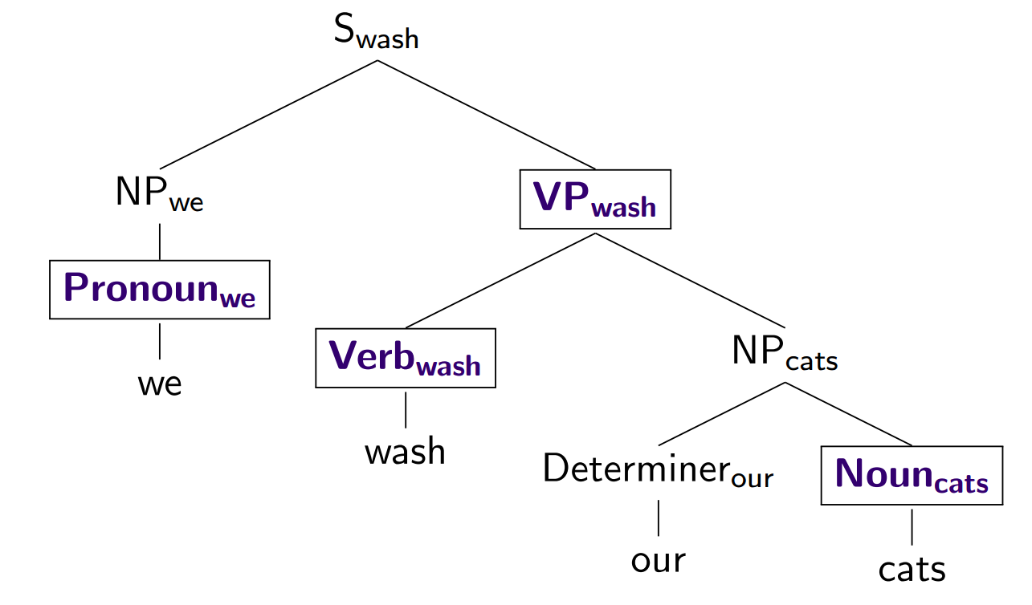
Lexicalizing a CFG

Slide 57
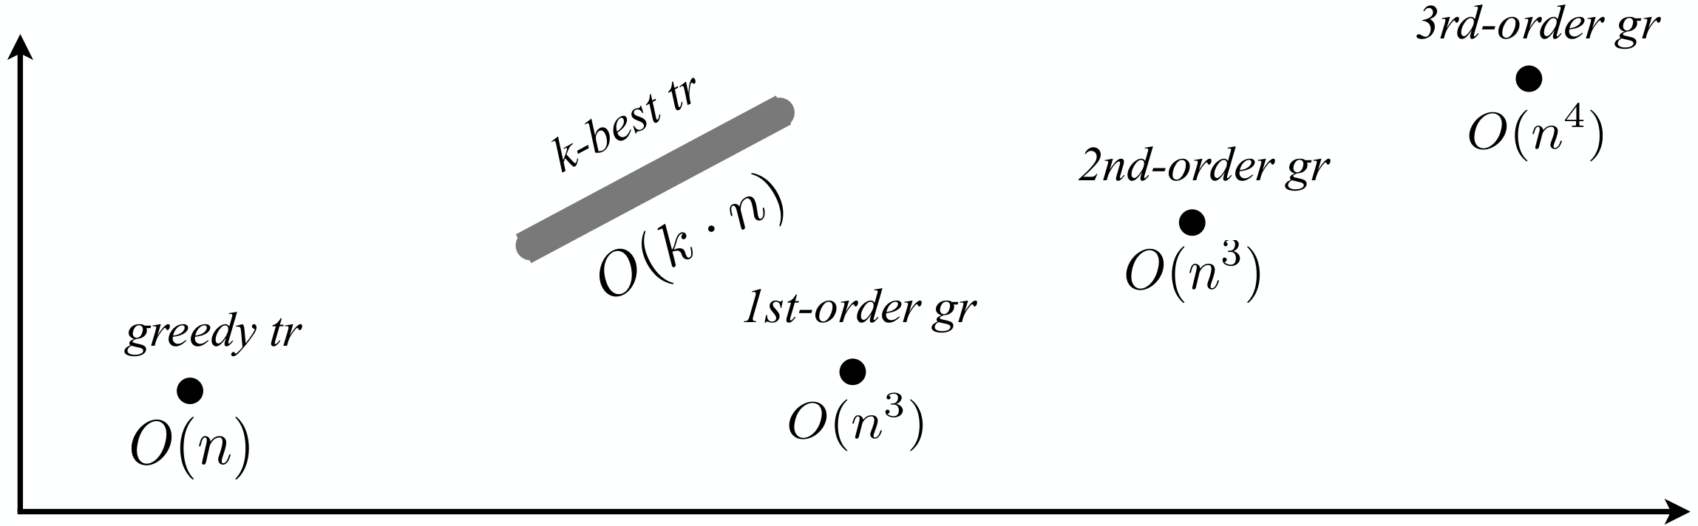
Parsing Algorithms
Transition-based
Graph-based
Fast, greedy, linear-time
Trained for greedy search
Features decide what to do next
Beam search, i.e. k-best
Slower, exhaustive algorithms
Dynamic programming, inference
Features used to score whole trees
Accuracy
Running time

Slide 58
Graph-based Parsing
Notes:
Arc-factored (1st order), 2nd order, 3rd order, and so on
Dynamic Programming for projective, MST for non-projective

Slide 59
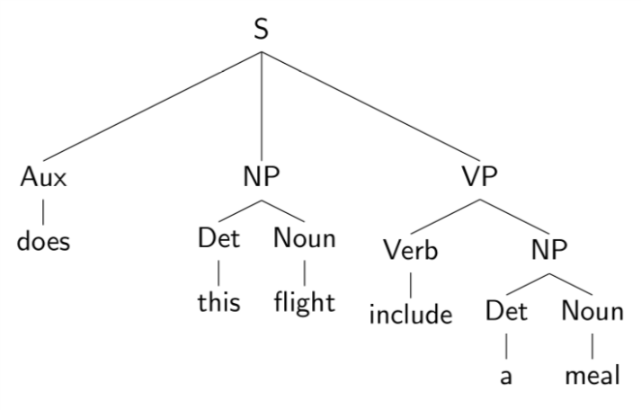
Evaluating Parses
Each parse tree is represented by a list of tuples:
Use this to estimate precision/recall!

